Slide 1
PENCIL SKETCH EFFECT
Transforming Digital Images into Artistic Sketches
DONE by:
BHARGOW N – E0322046
RISHITHA T – E0322026

Slide 2
PROJECT OVERVIEW
What is Pencil Sketch Effect?
A computer vision application that converts regular photographs into pencil sketch-style artwork using image processing techniques.
Key Features:
Grayscale pencil sketch conversion
Colored pencil sketch effect
Real-time webcam sketch filter
Save and export functionality

Slide 3
TECHNOLOGIES USED
Programming Language:
Python 3.x
Libraries:
OpenCV (cv2) - Image processing and computer vision operations
NumPy - Numerical computations and array manipulation
Hardware Requirements:
Webcam (optional, for real-time feature)
Standard computer with Python support

Slide 4
CORE CONCEPTS
Image Processing Techniques:
Grayscale Conversion - Reducing color complexity
Image Inversion - Creating negative images
Gaussian Blur - Smoothing and softening edges
Image Division - Dodge blend technique
Color Space Manipulation - BGR to Gray conversions

Slide 5
ALGORITHM – GRAYSCALE SKETCH
Step-by-Step Process:
Load Image - Read input image using OpenCV
Convert to Grayscale - Remove color information
Invert Grayscale - Create negative image
Apply Gaussian Blur - Blur the inverted image (21x21 kernel)
Invert Blurred Image - Create second inversion
Divide Images - Gray image ÷ Inverted blurred image
Scale Result - Multiply by 256 for proper intensity
Result: Realistic pencil sketch appearance

Slide 6
ALGORITHM – COLORED SKETCH
Using OpenCV's Built-in Function:
cv2.pencilSketch(image, sigma_s, sigma_r, shade_factor)
Parameters:
sigma_s (60) - Spatial window size, controls smoothness
sigma_r (0.07) - Range window size, controls color preservation
shade_factor (0.05) - Controls shading intensity
Output: Both grayscale and colored sketch versions

Slide 7
FEATURES – IMAGE CONVERSION
Static Image Processing:
✓ Load images from any path
✓ Support for multiple formats (JPG, PNG, BMP, TIFF)
✓ Side-by-side comparison view
✓ Optional save functionality
✓ Automatic file extension handling
✓ High-quality output preservation
Use Cases:
Portrait sketching
Artistic photo transformations
Digital art creation

Slide 8
FEATURES – REALTIME WEBCAM
Live Sketch Effect:
✓ Real-time video processing
✓ Side-by-side original and sketch view
✓ Interactive screenshot capture (Press 'S’)
✓ Smooth frame processing
✓ Easy exit option (Press 'Q’)
Applications:
Live demonstrations
Video conferencing filters
Interactive art installations

Slide 9
USER INTERFACE
Interactive Menu System:
Three main options:
Image to Pencil Sketch - Convert static images
Image to Colored Sketch - Create colored artwork
Webcam Pencil Sketch - Real-time processing
User-Friendly Features:
Clear menu navigation
Input validation
Path handling (with quote removal)
Save prompts
Status messages

Slide 10
CODE ARCHITECTURE
Modular Design:
Function 1: pencil_sketch()
Basic grayscale sketch conversion
Manual image processing pipeline
Single output image
Function 2: pencil_sketch_colored()
Advanced colored sketch
Uses OpenCV's pencilSketch function
Dual output (gray and color)
Function 3: webcam_pencil_sketch()
Real-time video processing
Frame-by-frame conversion
Interactive controls

Slide 11
TECHNICAL IMPLEMENTATION
Image Division Technique:
The core formula creates the sketch effect:
Sketch = (Gray Image / Inverted Blurred Image) × 256
Why it works:
Highlights edges and details
Simulates pencil strokes
Creates light/shadow contrast
Mimics hand-drawn appearance
Gaussian Blur Purpose:
Smooths harsh transitions
Reduces noise
Creates softer sketch lines

Slide 12
INPUT/OUTPUT EXAMPLES
Input Requirements:
Any standard image format
Clear, well-lit photographs work best
Portrait or landscape orientation
Minimum recommended: 640x480 resolution
Output Quality:
Same resolution as input
Grayscale or colored options
JPEG format (default)
Maintains aspect ratio

Slide 13
ADVANTAGES
Benefits of the Application:
✓ Easy to Use - Simple menu-driven interface
✓ Fast Processing - Efficient OpenCV algorithms
✓ Versatile - Multiple sketch styles available
✓ Real-time Capable - Live webcam processing
✓ Free & Open Source - Uses open-source libraries
✓ Customizable - Adjustable parameters
✓ No Internet Required - Works offline

Slide 14
LIMITATIONS & FUTURE ENHANCEMENTS
Potential Improvements:
Add GUI using Tkinter or PyQt
Batch processing for multiple images
Adjustable parameters via sliders
Additional artistic filters (oil painting, watercolor)
Video file processing support
Mobile app development
AI-enhanced sketch generation
Current Limitations:
Limited to predefined parameters
No GUI (command-line only)
Single image processing at a time
Fixed blur kernel size

Slide 15
APPLICATIONS
Real-World Use Cases:
Digital Art - Create artistic renditions of photos
Photography - Add creative effects to portraits
Education - Teach image processing concepts
Content Creation - Social media filters
Profile Pictures - Unique artistic avatars
Printing - Prepare images for print sketches
Professional - Quick sketch mockups for design

Slide 16
INSTALLATION & SETUP
Prerequisites:
pip install opencv-python
pip install numpy
Running the Program:
Install required libraries
Save the Python script
Run: python pencil_sketch.py
Follow on-screen menu prompts
System Requirements:
Python 3.6 or higher
4GB RAM (minimum)
Webcam (for real-time feature)

Slide 17
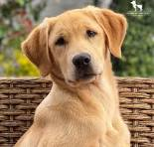
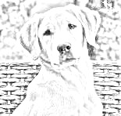
DEMO SCREENSHOTS
Original image vs. Pencil sketch comparison

Slide 18
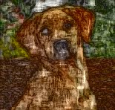
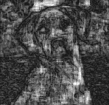
DEMO SCREENSHOTS
Colored sketch output example:

Slide 19
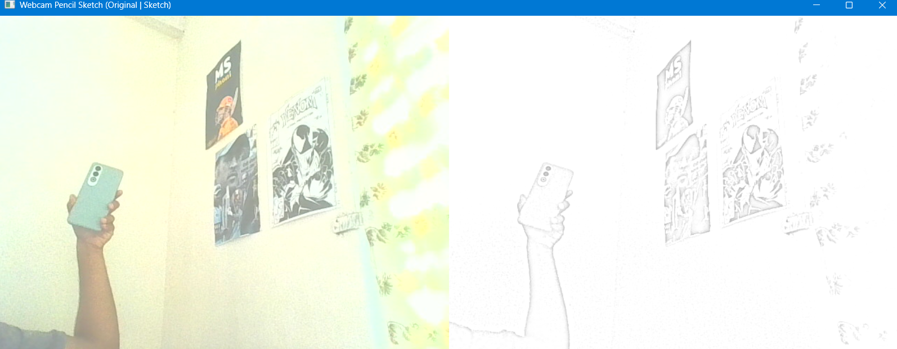
DEMO SCREENSHOTS
Webcam real-time processing screenshot

Slide 20
CONCLUSION
Project Summary:
Successfully implemented a pencil sketch effect application using computer vision techniques. The project demonstrates practical applications of image processing algorithms and provides multiple interaction modes for users.
Key Achievements:
✓ Three distinct processing modes
✓ Real-time video capabilities
✓ User-friendly interface
✓ Efficient algorithm implementation
✓ Flexible output options

Slide 21
REFERENCES
Technologies & Resources:
OpenCV Documentation: docs.opencv.org
NumPy Library: numpy.org
Python Official Site: python.org
Image Processing Tutorials
Computer Vision Research Papers
Learning Resources:
OpenCV Python Tutorials
Digital Image Processing Fundamentals
Computer Vision Applications

Slide 22
THANK YOU

